Slide 1
Mobile Application Development
David Drohan (ddrohan@wit.ie)

Slide 2

Firebase Database Setup & Usage

Slide 3
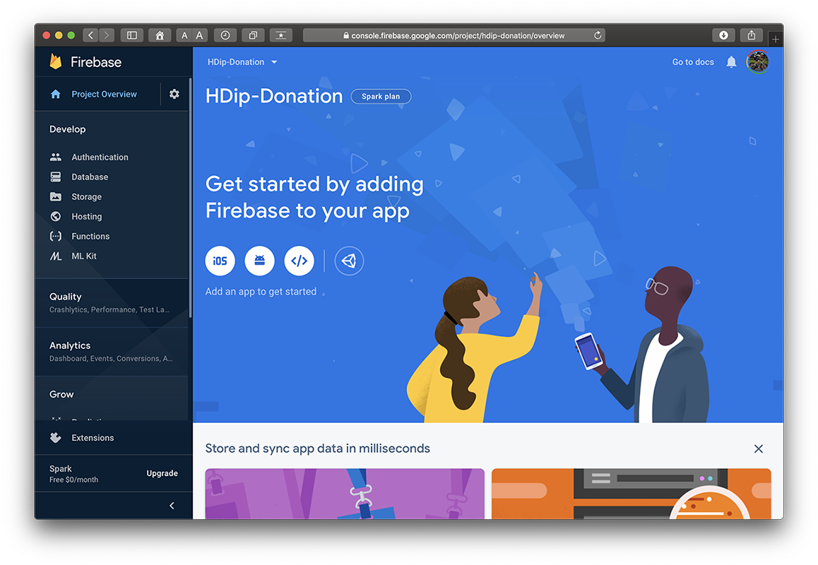
1. Create your Firebase Project

Slide 4
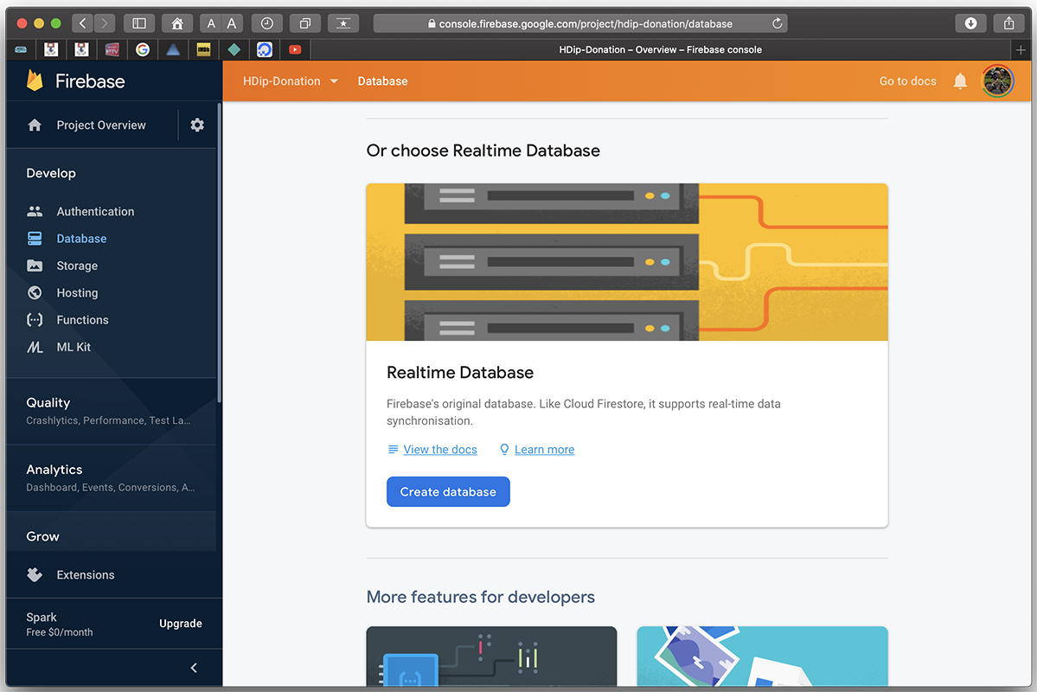
1. Create your Firebase Project

Slide 5
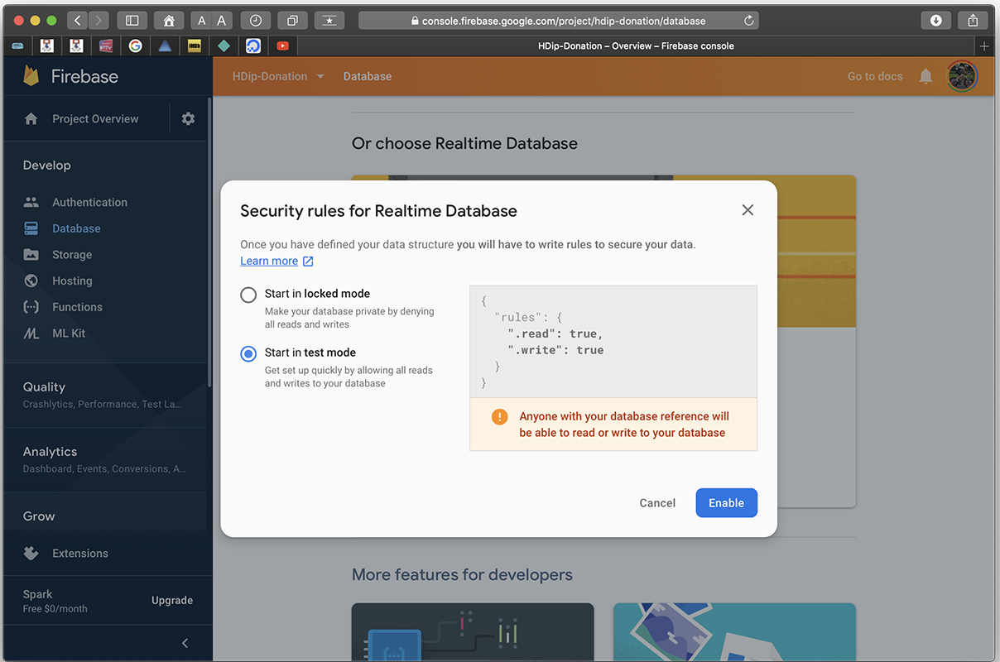
1. Create your Firebase Project

Slide 6
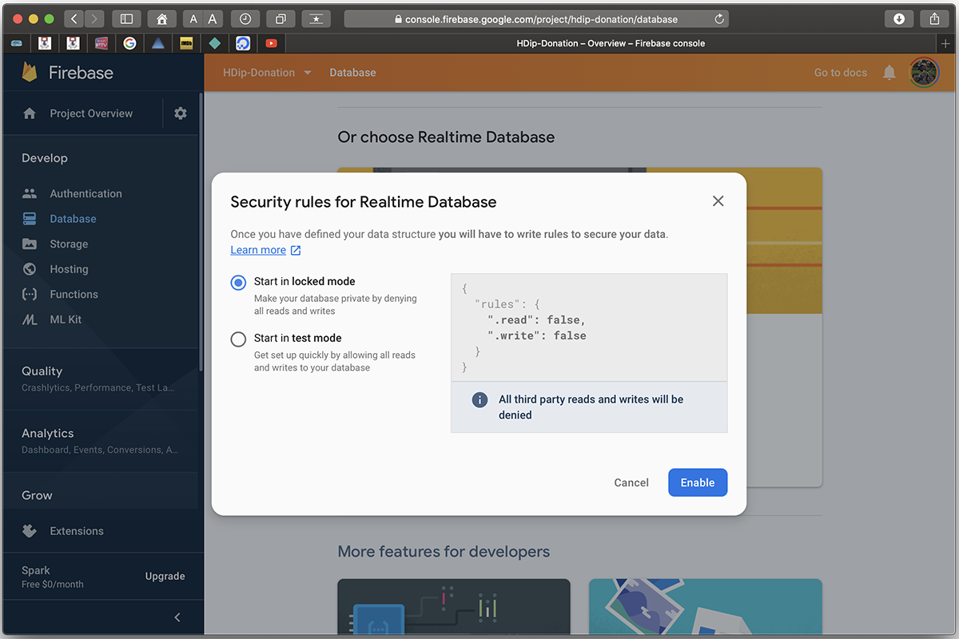
1. Create your Firebase Project

Slide 7
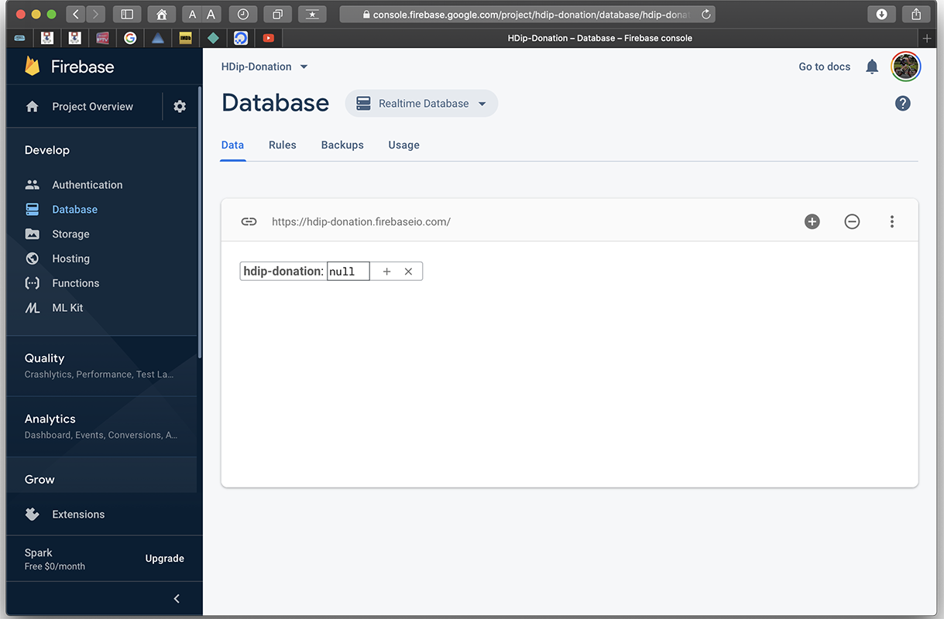
1. Create your Firebase Project

Slide 8
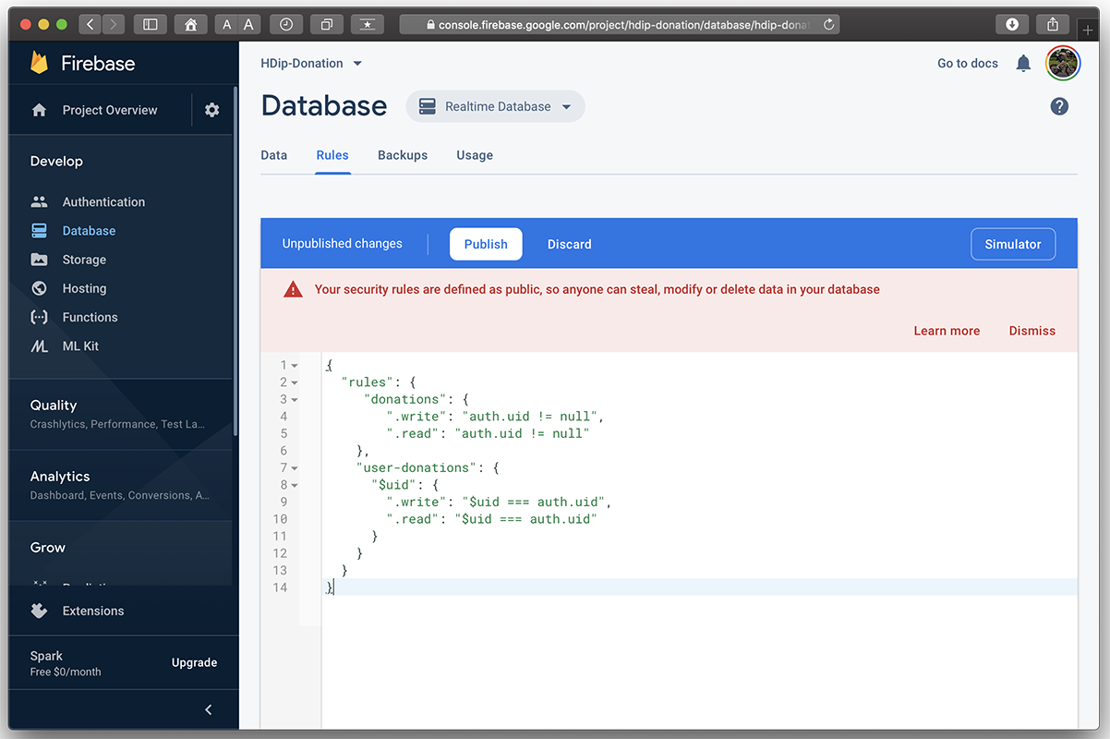
1. Create your Firebase Project

Slide 9
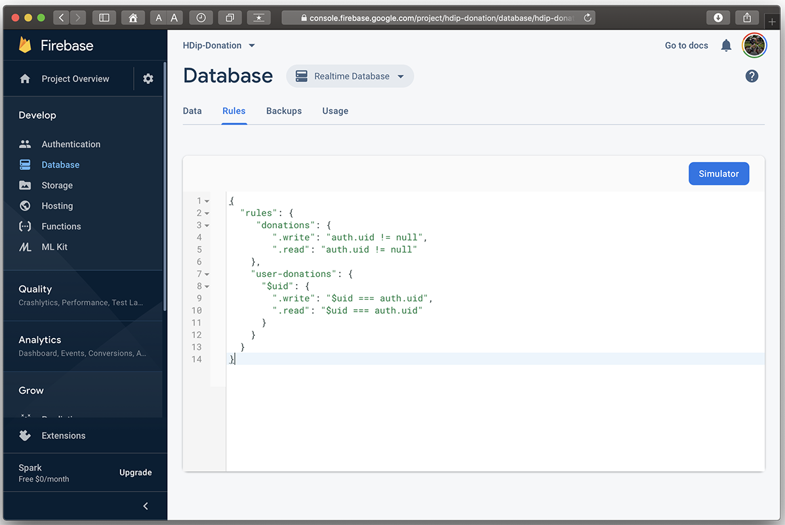
1. Create your Firebase Project

Slide 10
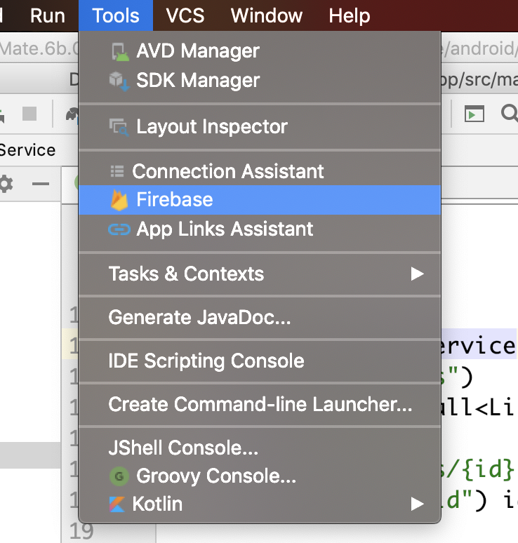
2. Setup Firebase in your App

Slide 11
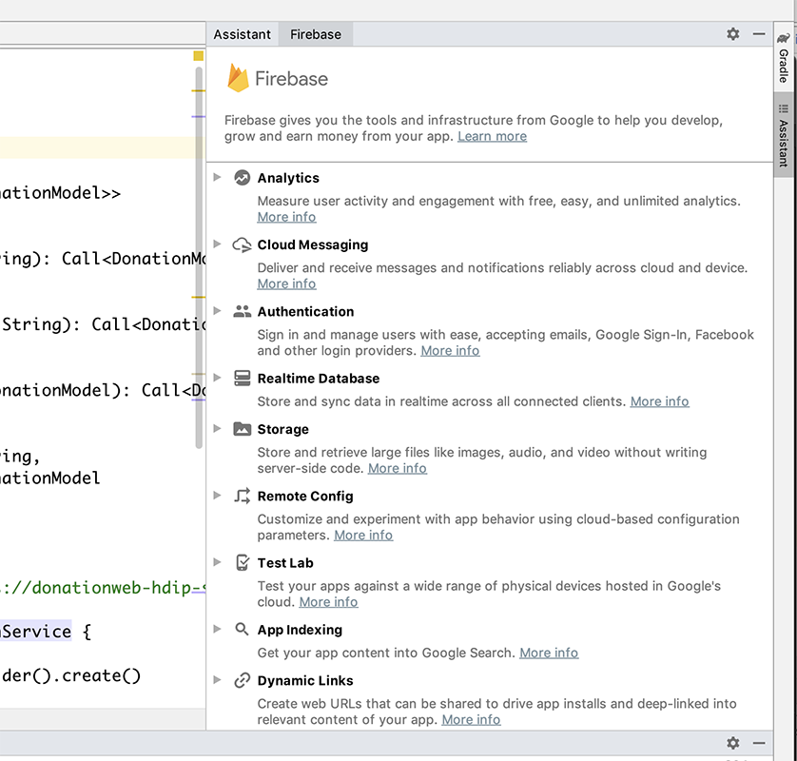
2. Setup Firebase in your App

Slide 12
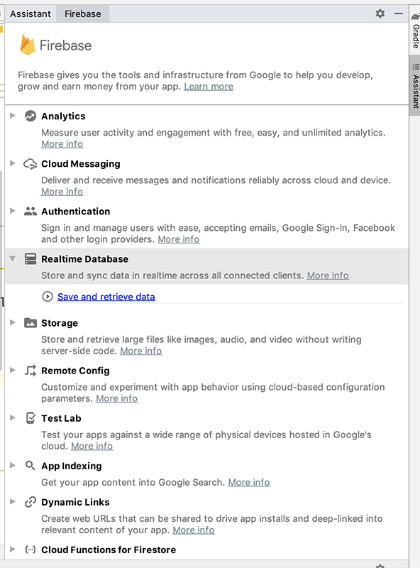
2. Setup Firebase in your App

Slide 13
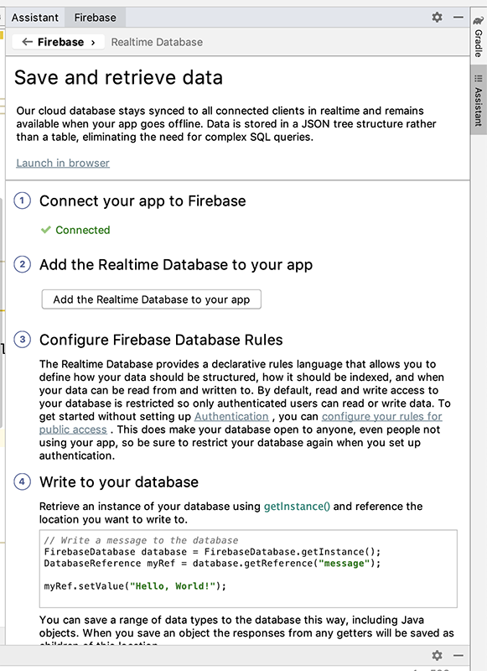
2. Setup Firebase in your App

Slide 14
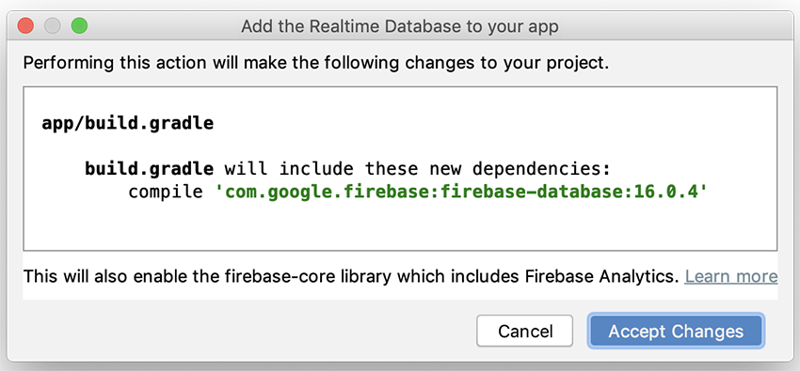
2. Setup Firebase in your App

Slide 15
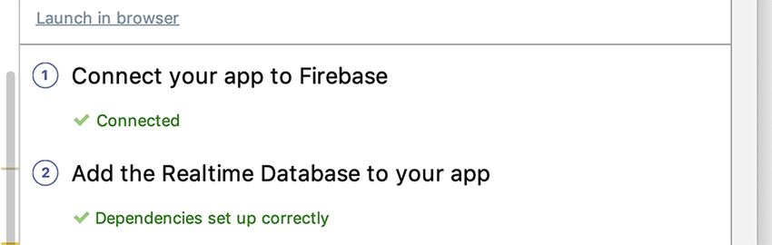
2. Setup Firebase in your App

Slide 16
3. Introduce Access Flow
https://github.com/firebase/quickstart-android

Slide 17
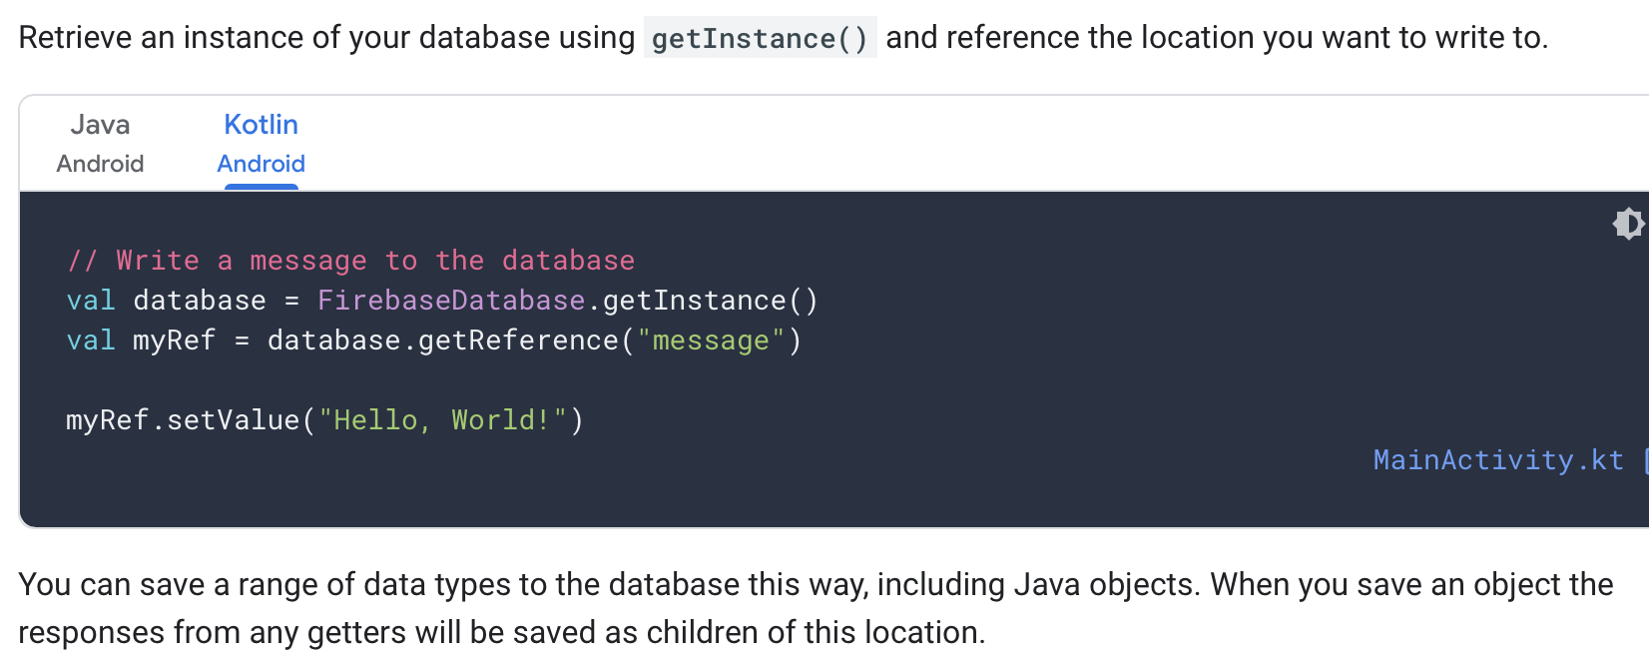
3. Introduce Access Flow – Write Basic Data

Slide 18
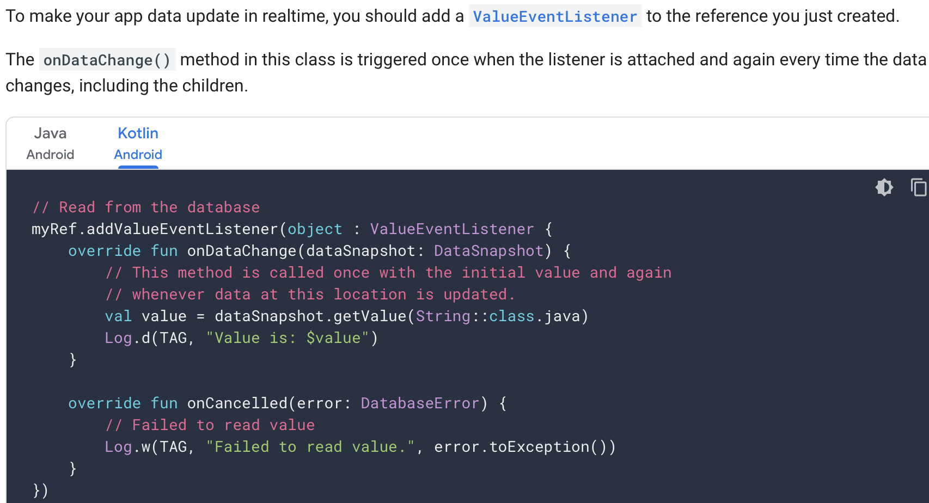
3. Introduce Access Flow – Read Basic Data

Slide 19
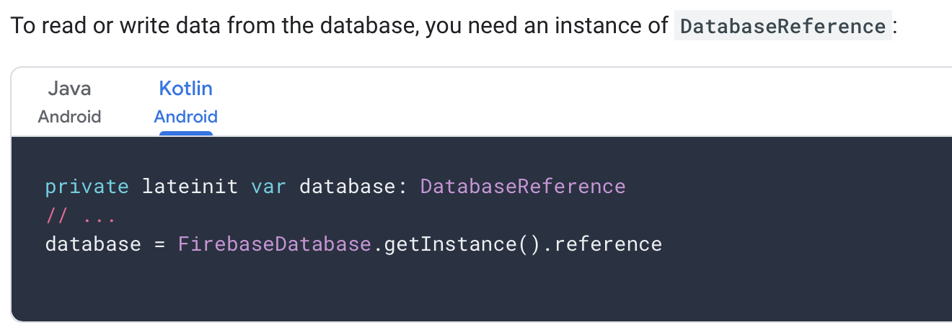
3. Introduce Access Flow – Write Complex Data

Slide 20
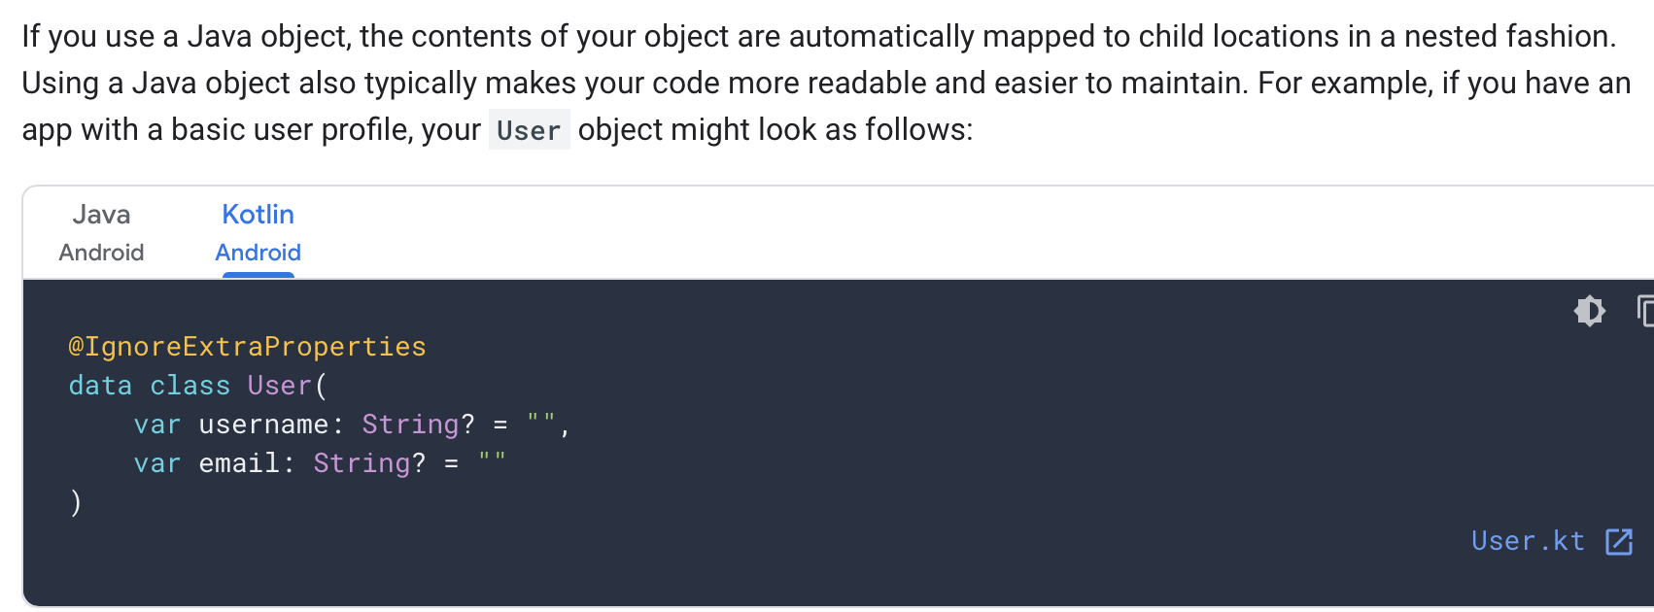
3. Introduce Access Flow – Write Complex Data

Slide 21
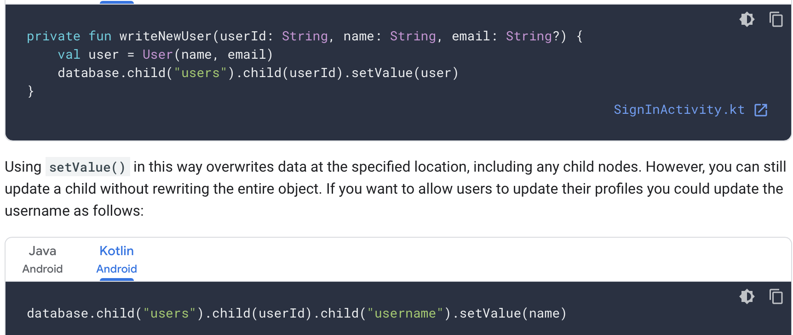
3. Introduce Access Flow – Write Complex Data

Slide 22
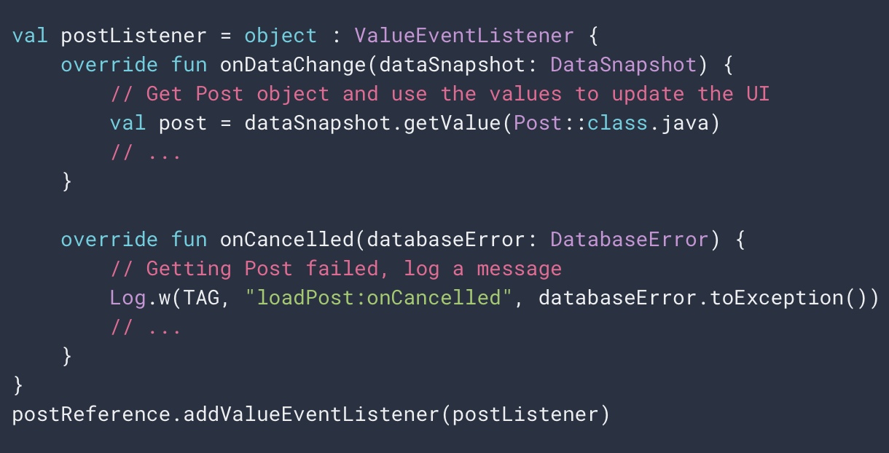
3. Introduce Access Flow – Read Complex Data
The following example demonstrates a social blogging application retrieving the details of a ‘post’

Slide 23
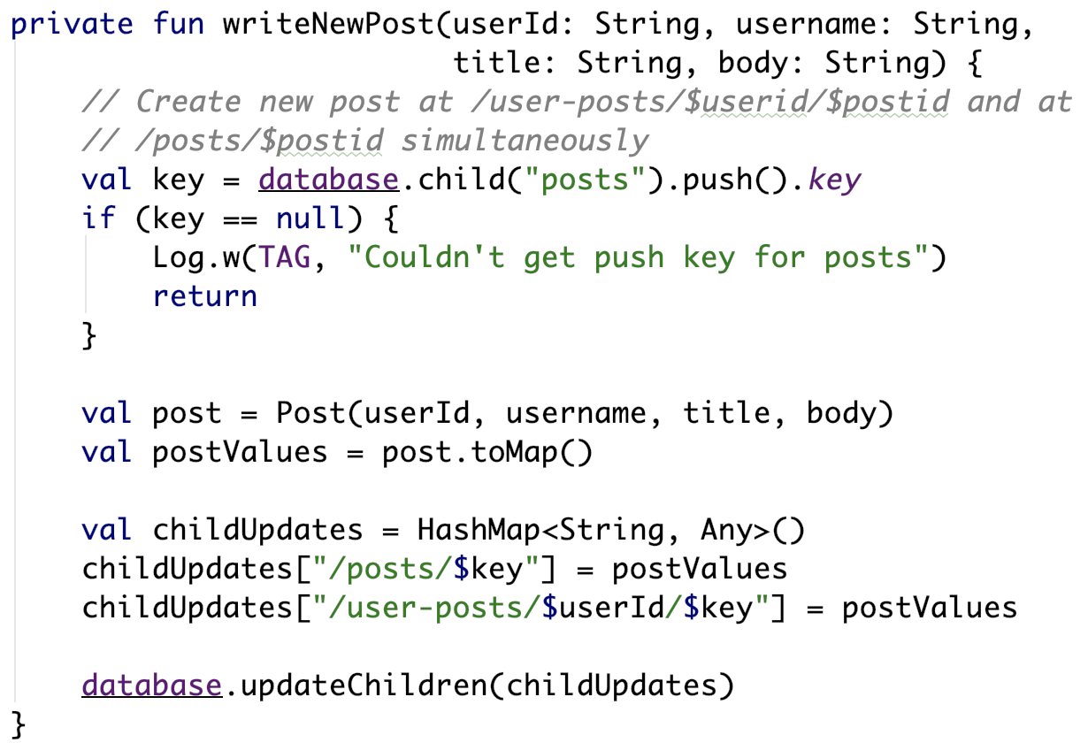
3. Introduce Access Flow – Read & Write Lists
Firebase takes care of the Key

Slide 24
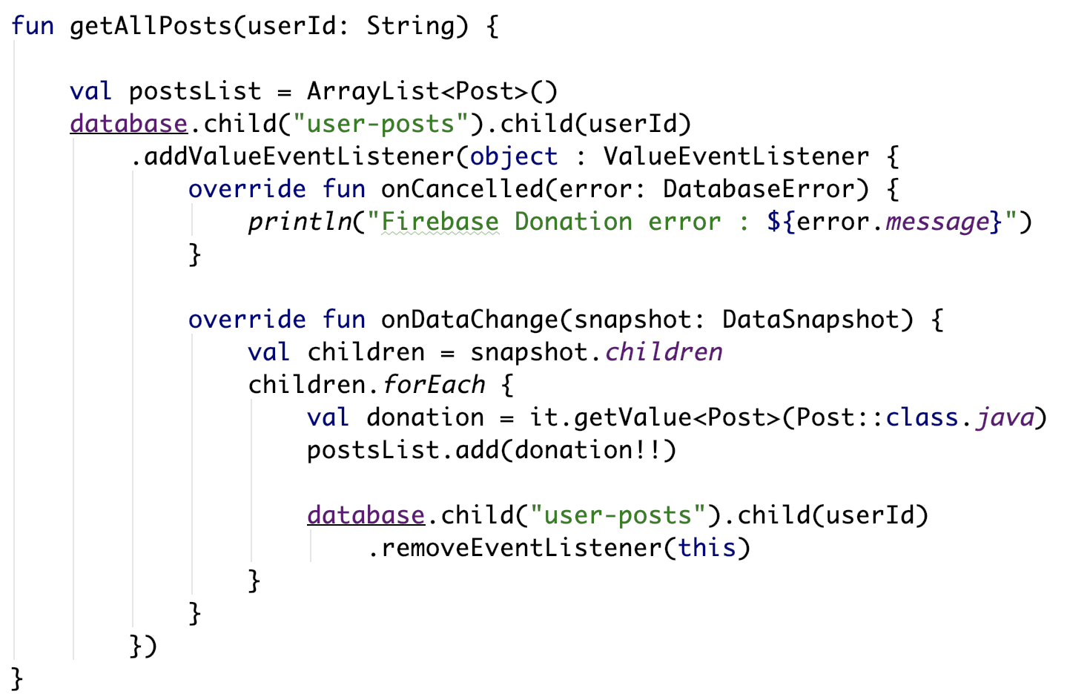
3. Introduce Access Flow – Read & Write Lists
Triggered whenever list ”user-posts” changes

Slide 25
Listening for Child Events
When working with lists, your application should listen for child events rather than the value events used for single objects
Child events are triggered in response to specific operations that happen to the children of a node from an operation such as a new child added through the push()method or a child being updated through the updateChildren()method
Each of these together can be useful for listening to changes to a specific node in a database
In order to listen for child events on DatabaseReference, attach a ChildEventListener:

Slide 26
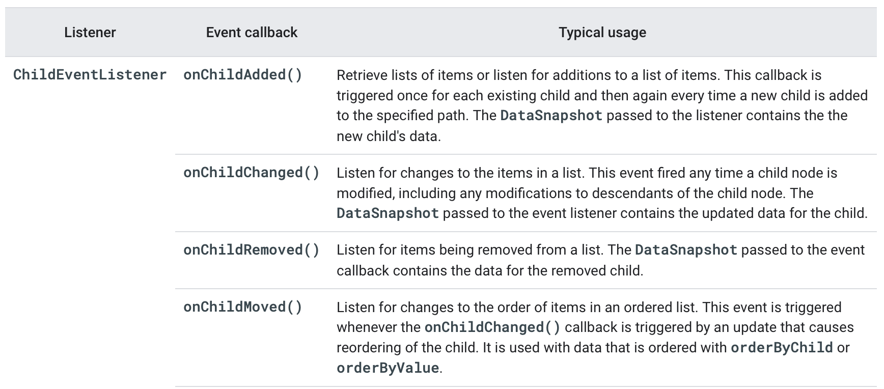
Listening for Child Events

Slide 27
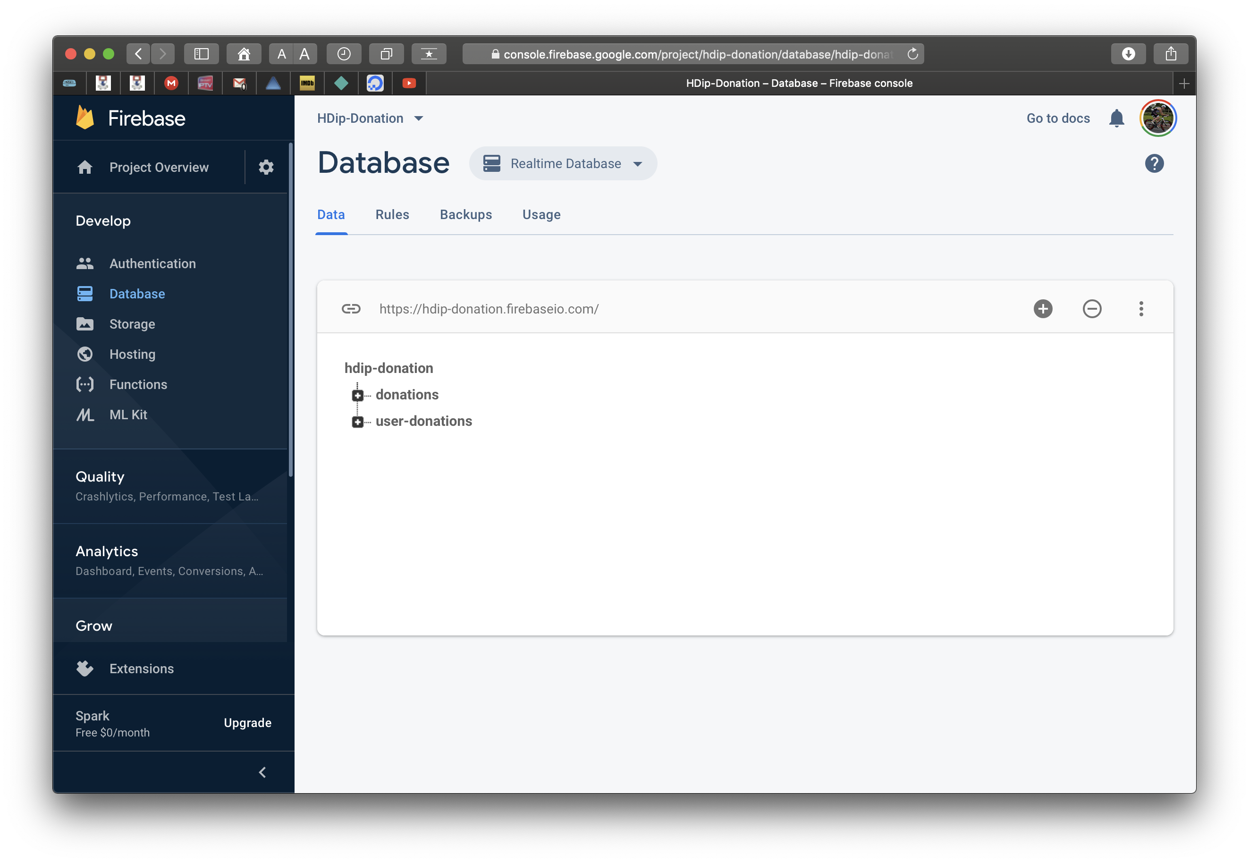
Viewing Your Data

Slide 28
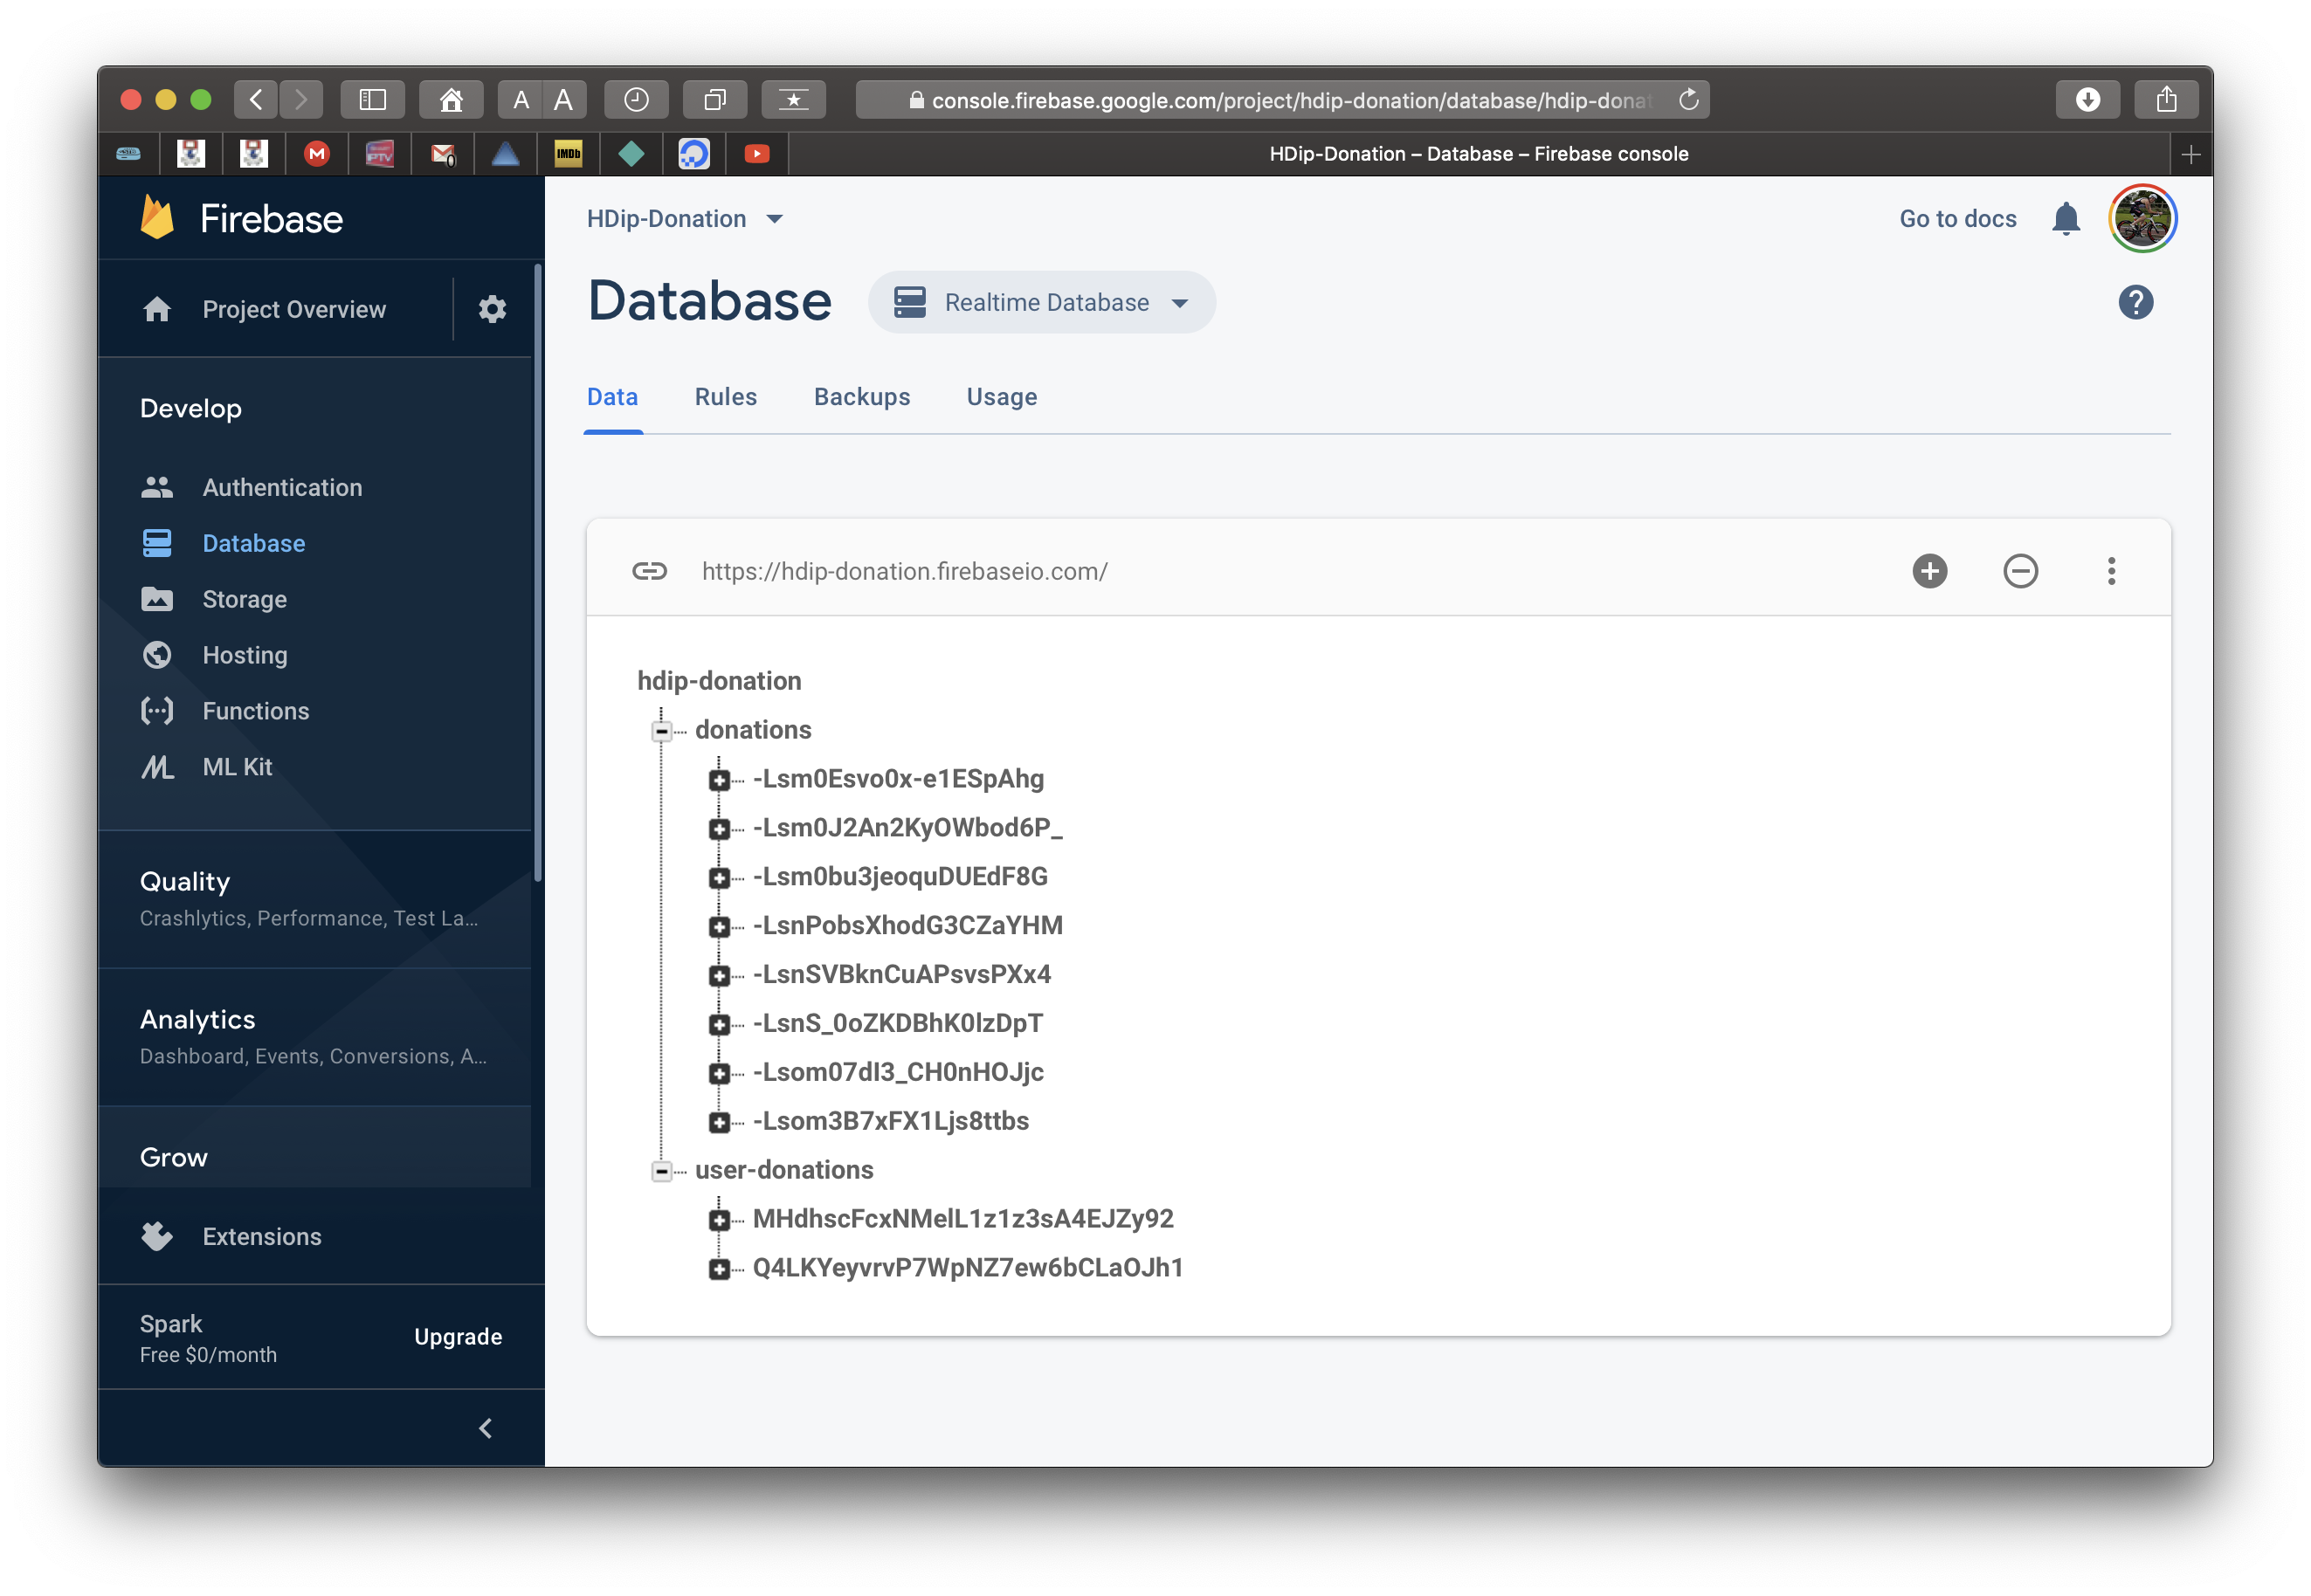
Viewing Your Data

Slide 29
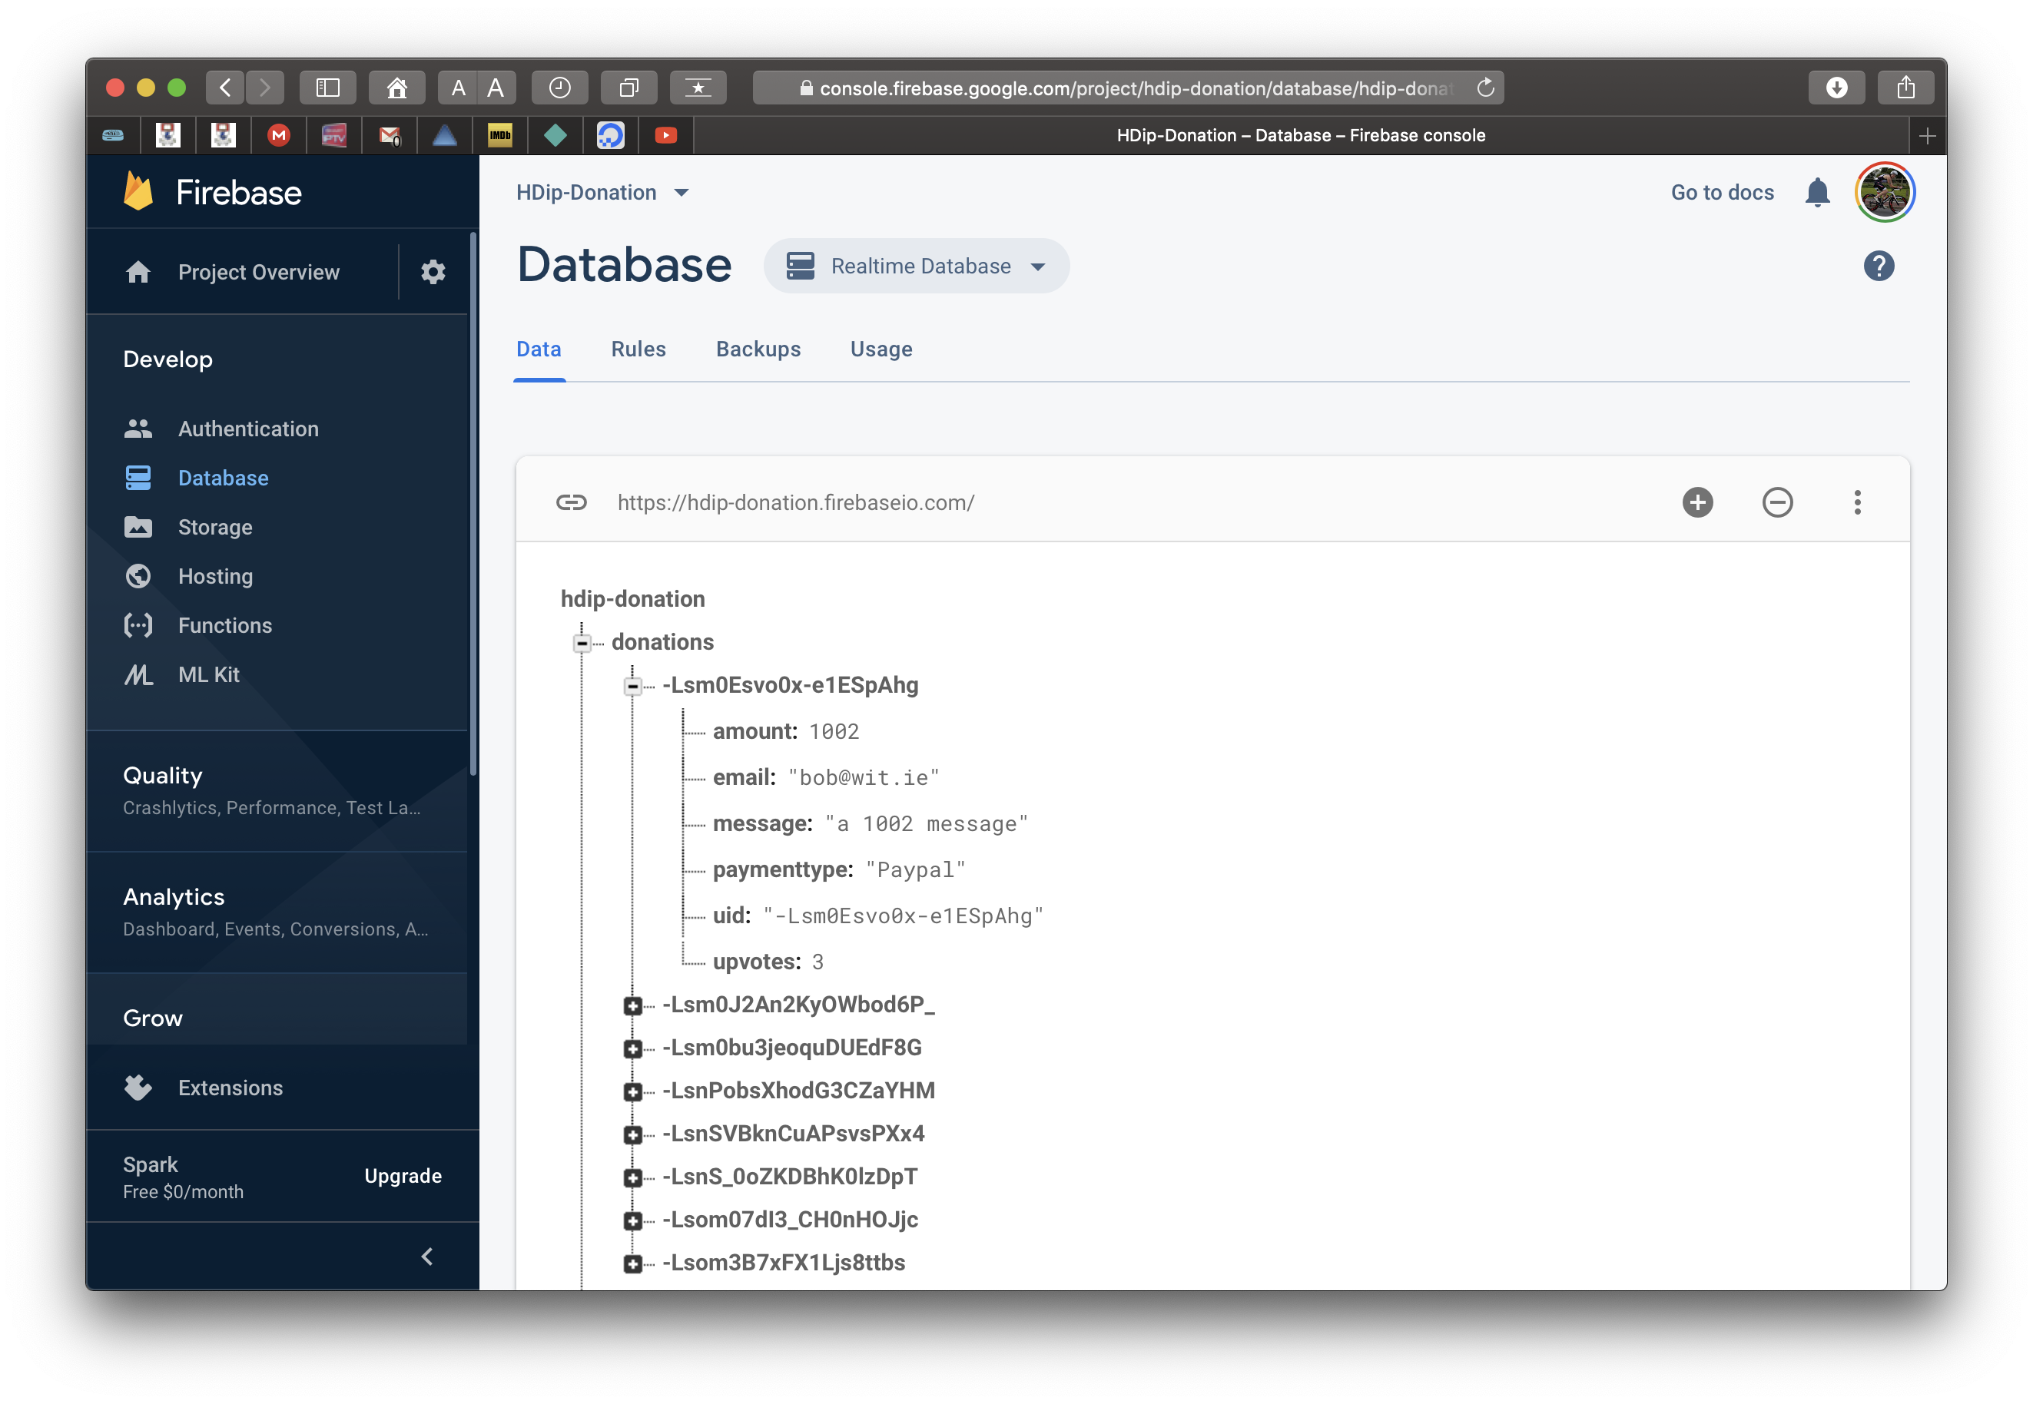
Viewing Your Data

Slide 30
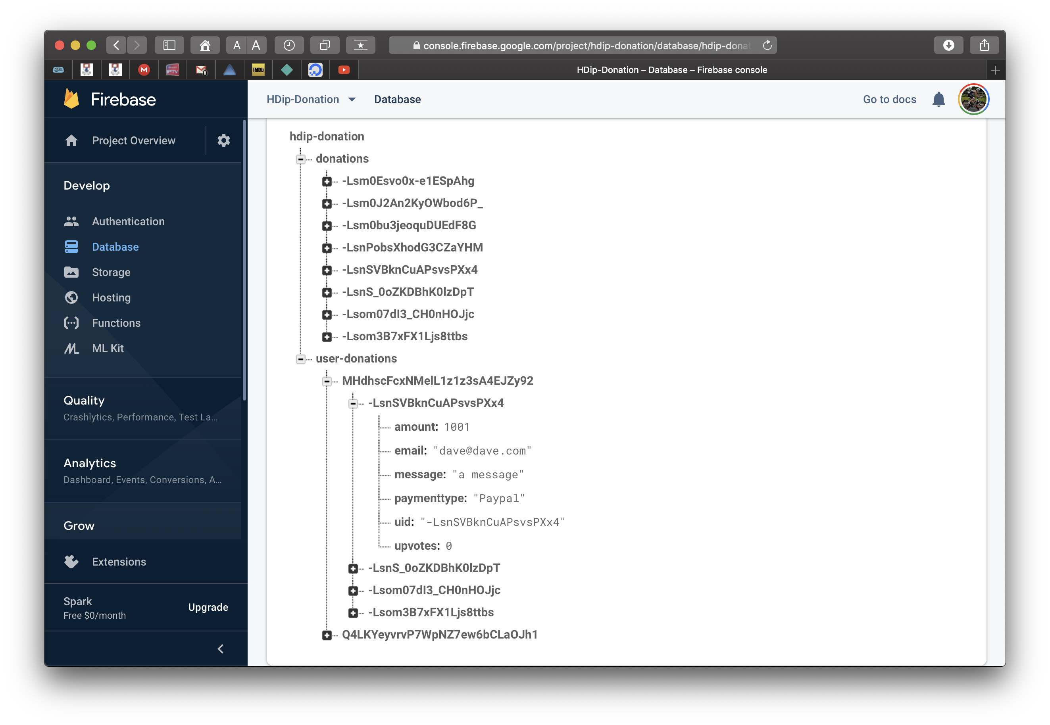
Viewing Your Data

Slide 31
We’ll look at how we store and retrieve ‘Donations’ to Firebase in the Code walkthrough and the Lab

Slide 32

References
https://console.firebase.google.com/
https://firebase.google.com/
https://firebase.google.com/docs/database/android/start
https://github.com/firebase/quickstart-android

Slide 33


